Slide 1
CODS 612
COMPUTATIONAL OPTIMIZATION IN FINANCE
Optimal Execution
with Power-Law Market Impact
Extending the Almgren-Chriss model from linear to empirical power-law impact
Ali Almehairbi
Mohamed Alhmoudi
Professor Yerkin · Spring 2026

Slide 2
THE PROBLEM
Balance two opposing costs.
SCENARIO
1,000,000
shares to liquidate over 50 half-hour periods.
OBJECTIVE FUNCTION
Minimize
min Σ [ η·|v_{k}|^{1+β} + γσ²x_{k}² ]
impact cost
risk penalty
how fast you trade
how long you hold
Sell fast → crash the price
Hold long → exposed to volatility
β impact exponent γ risk aversion
η impact coeff. σ volatility
Optimal Execution | Ali & Mohamed | CODS 612
02

Slide 3
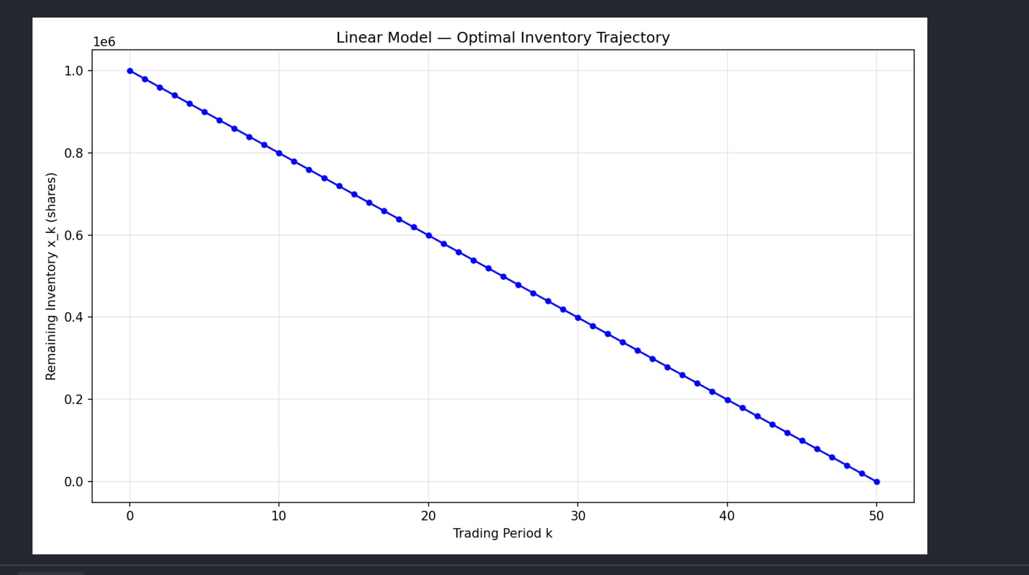
PART I
The Linear Baseline
β = 1.0 → Quadratic Program
η · v² impact is quadratic in trade size.
CLOSED-FORM SOLUTION
x_{k} = X · sinh(κ(N − k)) / sinh(κN)
κ = √( γσ² / η ) · controls curvature.
KEY RESULT
≈ 20,000 shares per period.
Near-TWAP at professor's γ = 2.5e-6.
Optimal inventory trajectory · linear model
Optimal Execution | Ali & Mohamed | CODS 612
03

Slide 4
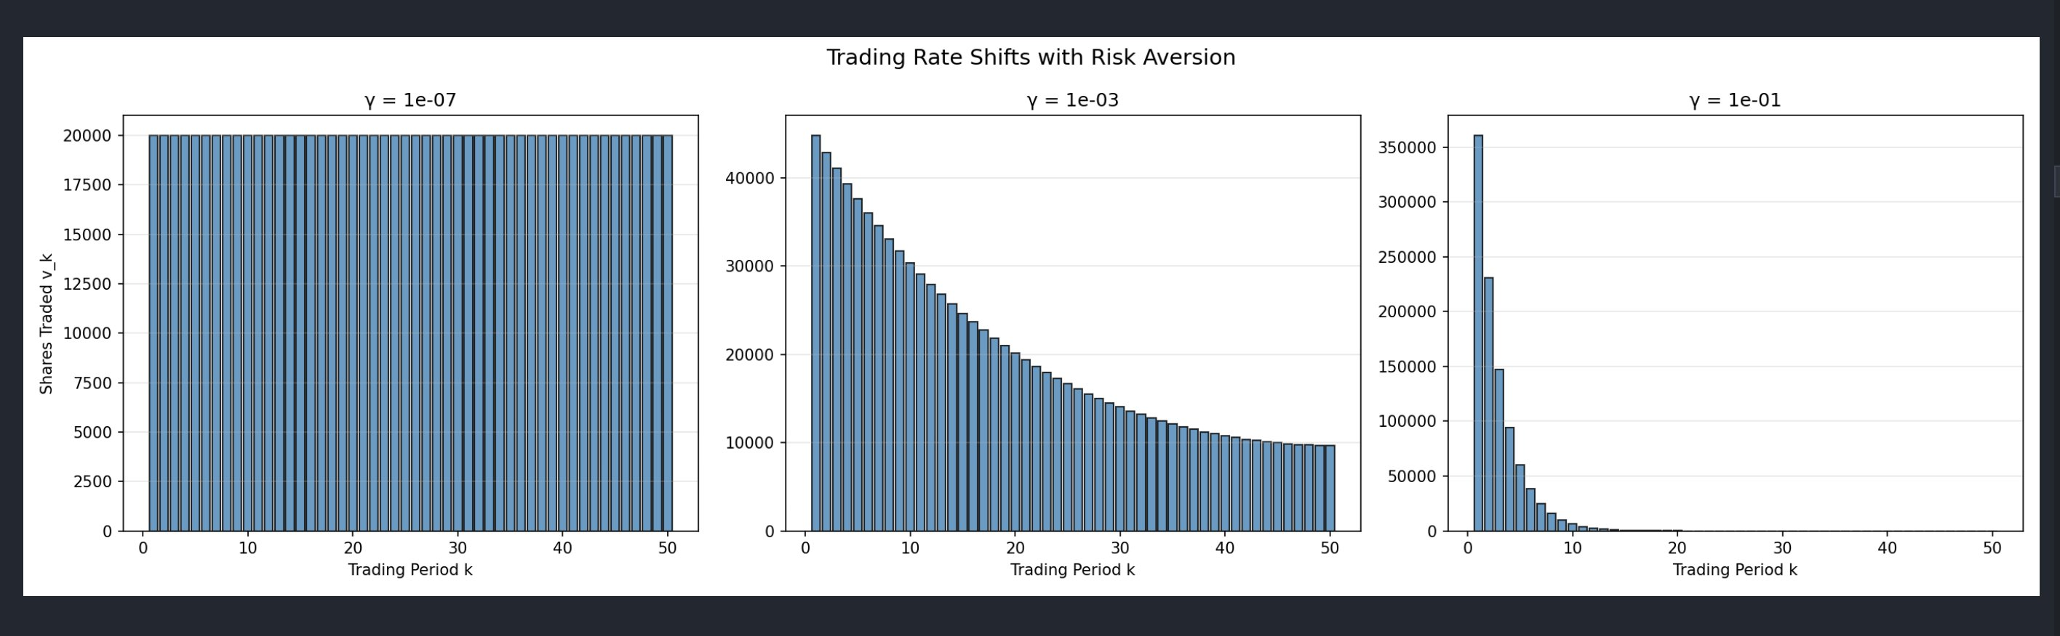
SENSITIVITY ANALYSIS
Risk Aversion Controls Urgency
γ is the dial that balances impact cost against risk penalty.
LOW γ
MID γ
HIGH γ
Patient
Tapered
Panicked
Uniform selling — TWAP.
Gentle front-loading.
Dump most early, flatten fast.
Optimal Execution | Ali & Mohamed | CODS 612
04

Slide 5
PART II ·
Why Linear Impact Is Wrong
Empirical research — the "Square Root Law" — shows real market impact follows a power law with β ≈ 0.5–0.6.
LINEAR MODEL
POWER-LAW MODEL (reality)
cost ∝ v²
cost ∝ |v|^{1.6}
Convex: big trades are punished quadratically.
Concave: big trades cost less than the linear model fears.
DOUBLING A TRADE
Linear says cost → × 4 Power-law says cost → × 3 — the linear model is unnecessarily scared of big trades.
Optimal Execution | Ali & Mohamed | CODS 612
05

Slide 6
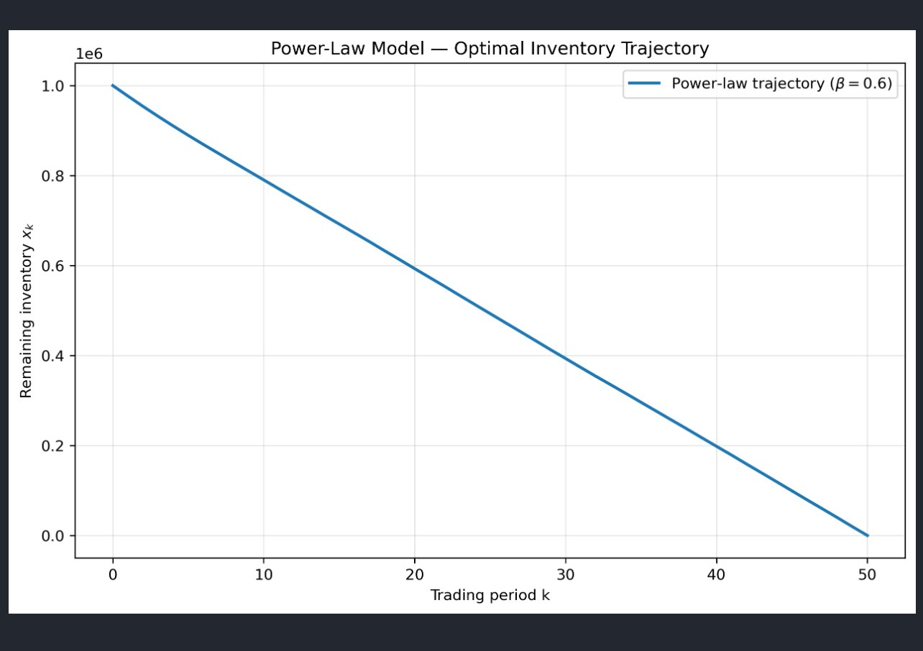
IMPLEMENTATION
The Power-Law Model — β = 0.6
OBJECTIVE
min Σ [ η·|v_{k}|^{1.6} + γσ²x_{k}² ]
SOLVER
scipy.optimize.minimize · SLSQP
DECISION VARS
N−1 intermediate x_k
FIXED
x₀ = X, x_N = 0
SANITY CHECK
β = 1.0 recovers linear (< 0.08%)
Optimal inventory trajectory · power-law (β = 0.6)
Optimal Execution | Ali & Mohamed | CODS 612
06

Slide 7
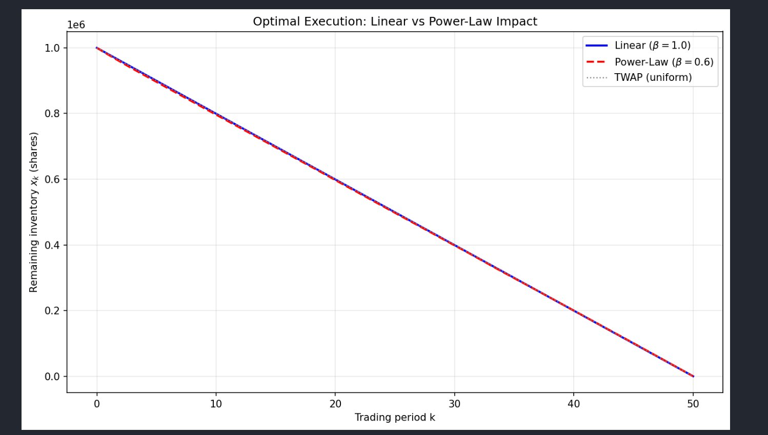
RESULT AT BASELINE
Linear vs Power-Law Result
COST GAP AT BASELINE
$92
0.10% over optimum
At β = 0.6 and γ = 2.5e-6 both models produce near-TWAP trajectories.
Optimal Execution | Ali & Mohamed | CODS 612
07

Slide 8
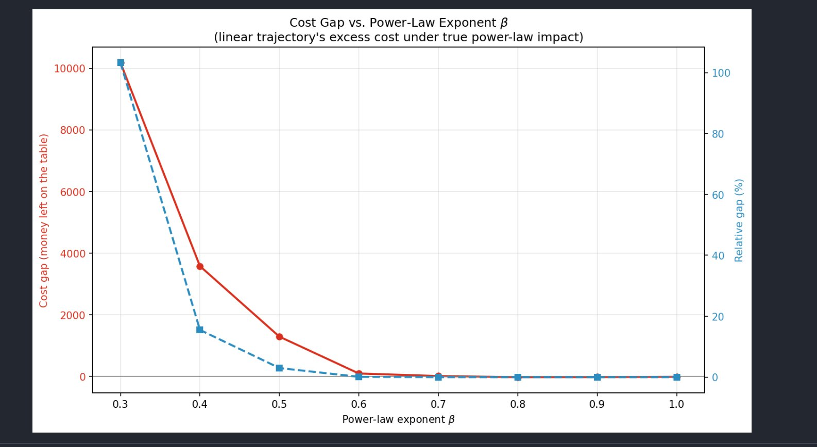
THE PUNCHLINE
When the market is more non-linear,
the linear model breaks down.
AT β = 0.3
103%
over optimum — the linear strategy costs DOUBLE.
β = 0.6
$92 0.1%
β = 0.5
$1,288 3%
β = 0.4
$3,578 15.5%
β = 0.3
$10,184 103%
Optimal Execution | Ali & Mohamed | CODS 612
08

Slide 9
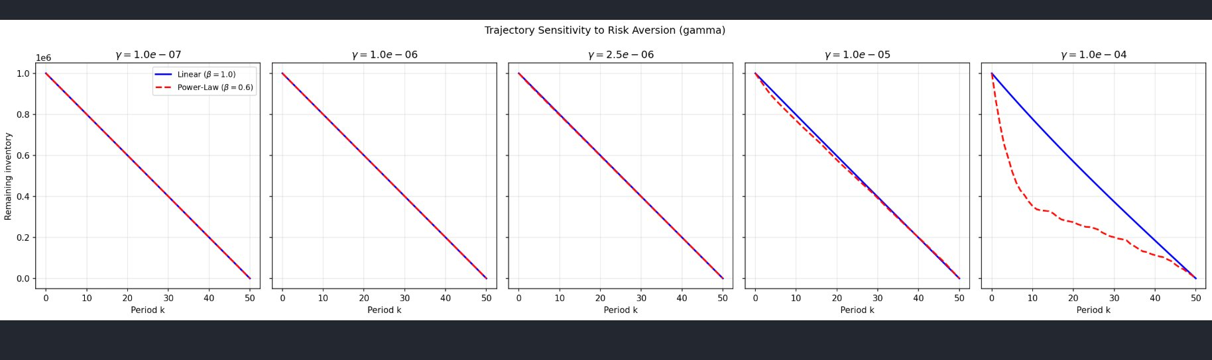
SECOND DIMENSION
Model Choice Matters Most Under Urgency
LOW γ
MID γ
HIGH γ
Both models agree — near TWAP.
Small visible divergence in shape.
Models diverge meaningfully.
Optimal Execution | Ali & Mohamed | CODS 612
09

Slide 10
IN SUMMARY
Three Takeaways
01
Linear is convenient.
Quadratic Program with a closed-form sinh solution. Easy to solve, easy to teach.
02
Power-law is reality.
Empirical impact scales as |v|^β with β ≈ 0.5–0.6. Big trades cost less than linear predicts.
03
The error is non-uniform.
At baseline parameters, < 0.1%. But it EXPLODES as β decreases or γ increases — up to 103%.
Practical implication: execution desks must calibrate impact models empirically — never assume linearity.
Optimal Execution | Ali & Mohamed | CODS 612
10

Slide 11
BIBLIOGRAPHY
References
[1]
Almgren, R. & Chriss, N. (2000). Optimal execution of portfolio transactions. Journal of Risk, 3(2), 5–39.
[2]
Almgren, R., Thum, C., Hauptmann, E., & Li, H. (2005). Direct estimation of equity market impact. Risk, 18(7), 58–62.
[3]
Bouchaud, J.-P. (2010). Price impact. Encyclopedia of Quantitative Finance.
[4]
Cornuéjols, G. & Tütüncü, R. (2007). Optimization Methods in Finance. Cambridge University Press. (course textbook)
TOOLS
Python · NumPy · SciPy (SLSQP) · Matplotlib
Optimal Execution | Ali & Mohamed | CODS 612
11

